Slide 1



GOVERNMENT COLLAGE OF ENGINEERING KARAD
ExpertsHub Machine Learning/ Artificial Intelligence Summer Internship 20-21
Group members:
Aditi Dhiraj Kowale
Deepti Deepak Nangare
Manasi Vilas Ghevade
Komal Sanjay Lakde
Pratiksha Dattatray Thorat
Mayuri Ananda Gurav

Slide 2

House Price Prediction System

Slide 3
Introduction
01
Objective
Buying a House is a stress full thing.
02
Buyers are generally not aware of factors that influence the house prices.
Objective
03
To provide solution on this big problem.
Objective
04
Objective
Our project is based on MLAI. Based on certain specifications of your future home it will try to guess most accurate price.

Slide 4

1. Introduction
CONTENTS
2. Contents
3. Technology used
4. Home Page
5. Advantages
6. Conclusion
7. Q&A

Slide 5
Technology Used
HTML
CSS
Bootstrap
Hyper Text Markup Language. HTML element tells browser how to display the content. It structure of web pages.
Cascading Style Sheet. It is styled webpage (colors, layout, styles) . More advanced and comprehensive .
It is open source CSS Framework. A free collection of tools for creating websites & web applications
JS
ML
JS is the most powerful and flexible programming language of web.
A method of data analysis that automates analytical model building.
It is branch if Artificial Intelligence.

Slide 6
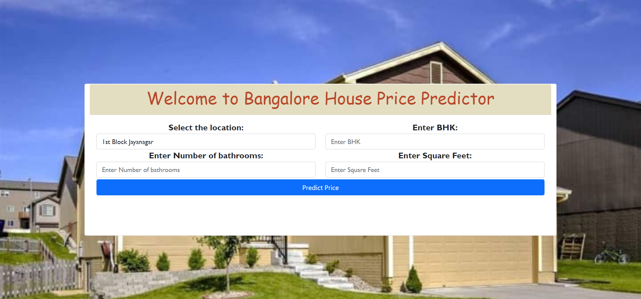
HOME PAGE
You can simply impress your audience and add a unique zing and appeal to your Presentations. Get a modern PowerPoint Presentation that is beautifully designed.

Slide 7
Advantages
The system is very useful for buyers as well sellers.
Its very time saving system
No need of middle man
An individual can directly make deal with house owner without any broker
No need to visit all places only visit those we want.

Slide 8
Conclusion
This system work as a middle man. In other words we can say that this system act as a real estate agent which help people to find their dream house.
User just need to put the parameters and quick result they get. No need to do struggles for finding home.
Not only house buyers but house sellers can use this site to check their house price if the want to sell.
We have successfully designed the house price prediction system with the help of HTML, CSS, JS, BOOTSTRAP and ML

Slide 9
Q & A

Slide 10

THANK YOU

